Slide 1
Exploring data technologies using free tools
Phil Austin and Dom Winsor, October 2024

Slide 2
Purpose & Goals
An overview, with demos, of how to develop your data skills using free tools for data manipulation, visualisation and transformation using languages like SQL and Python in the cloud and on your Windows laptop.
Gain Insight: Applied Data Engineering
Enable Self-study: Tools & Resources

Slide 3
Format
Talk focused on demo’s - questions at the end
Write questions on cards
Read yours out at the end
Add cards to the table in the break
Have an answer, or a tip?
Use a card to answer and place next to the corresponding question
Place tips on relevant area on table

Slide 4
In this session
Intros & Overview
Working with data
In the cloud (Azure storage accounts; ADF)
Intro to VS Code
Azure Data Factory setup
Databricks -setting up & demo notebook
Using free software on a Windows Laptop (PySpark)
Quick SQL & Python getting started locally demo
Topics
Getting setup
Data basics
Data Engineering techniques

Slide 5
About Us

Slide 6
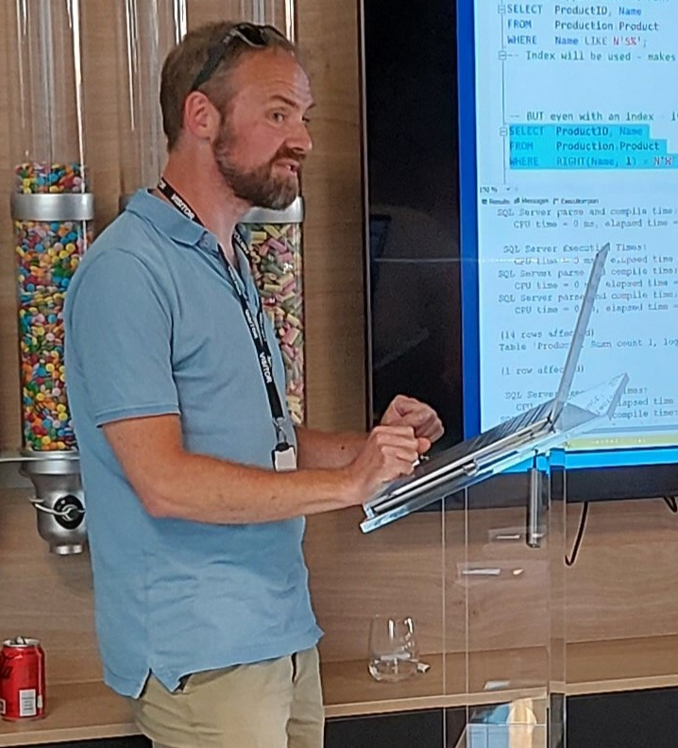

Phil Austin
Senior Consultant
Data & AI

Slide 7
Dom Winsor
Career includes tech design, development, management & support roles ranging from Data Engineering to Front-End Web Solutions. Currently a…
Product Manager
Working for the UK Civil Service, on Data Integration Platforms

Slide 8
Scope
Supporting tools
Code editing
Database Access
Cloud overview
Environment setup pointers
Working with some data (acquire, manipulate, present)
Offline
Running a local database & Python/PySpark environment
Working with some data (acquire, manipulate, present)

Slide 9
Demo’s

Slide 10
Azure
Go to Azure.com
Click ‘Try Azure for free’
You will need:
An email address
A mobile phone
A credit/debit card – don’t worry you won’t be charged!
Choose United Kingdom or US region
$200 credit / 30 days
Some resources are free longer / permanently
Notes:
DOM

Slide 11
Data engineering using your free credits
Resource group
Notes:
PHIL

Slide 12

Data engineering using your free credits
File
Resource group

Slide 13

Data engineering using your free credits
File
Data Factory
Databricks
Resource group

Slide 14

Data engineering using your free credits
File
Data Factory
Storage Account
Resource group

Slide 15

Data engineering using your free credits
Res
File
Data Factory
Storage Account
Databricks
Resource group

Slide 16
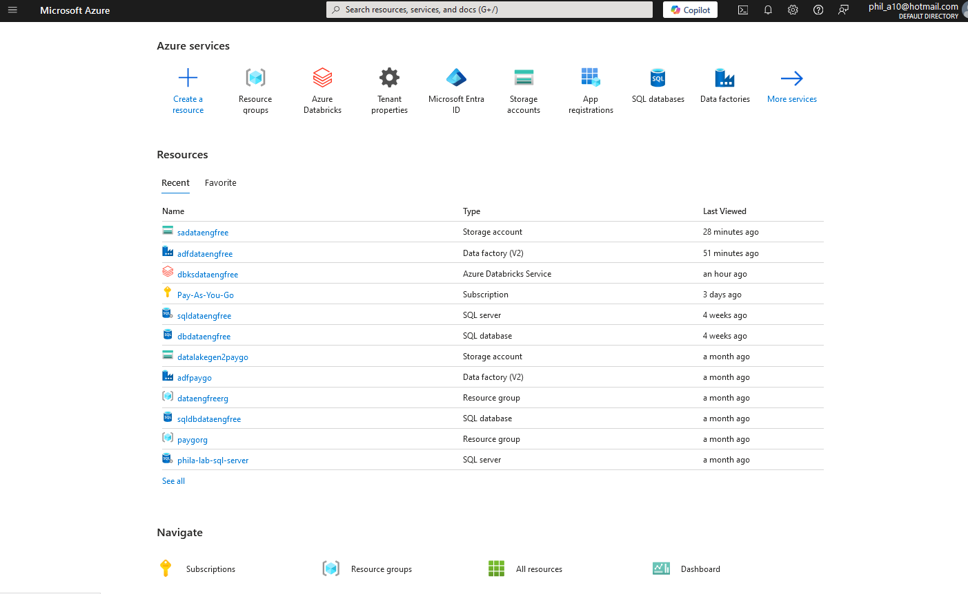
Azure Portal

Slide 17
VS Code
Free download
Very large number of plug-ins/extensions – most free

Slide 18
Azure CLI
Install by following links from: https://learn.microsoft.com/en-us/cli/azure/install-azure-cli
For VS Code:
Azure CLI Tools
Azure Developer CLI

Slide 19
Demo

Slide 20
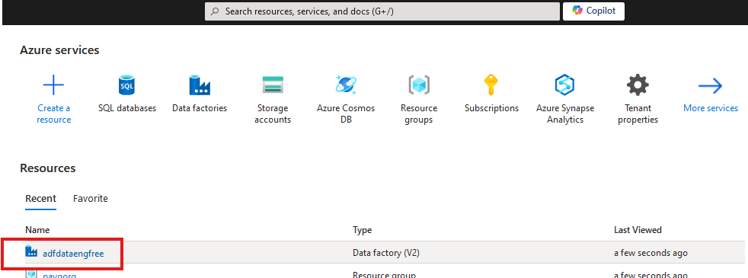
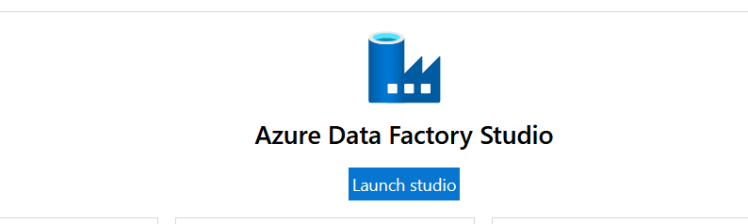

Slide 21
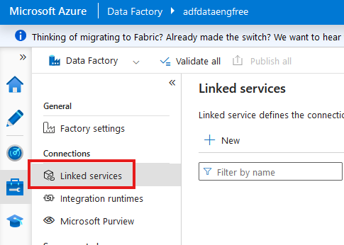

Slide 22
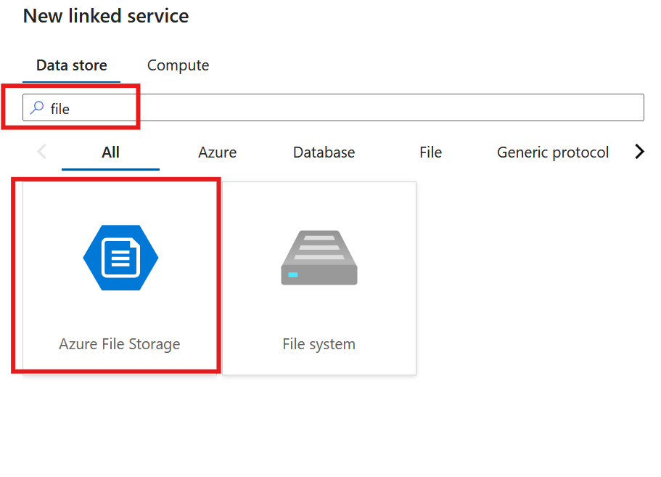

Slide 23
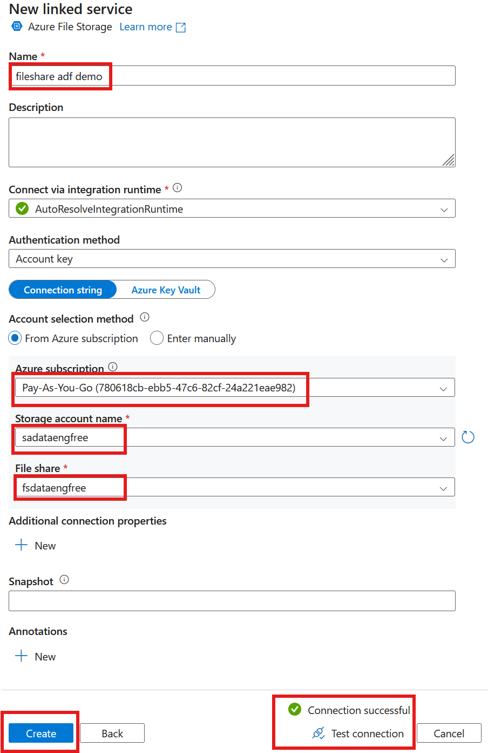

Slide 24
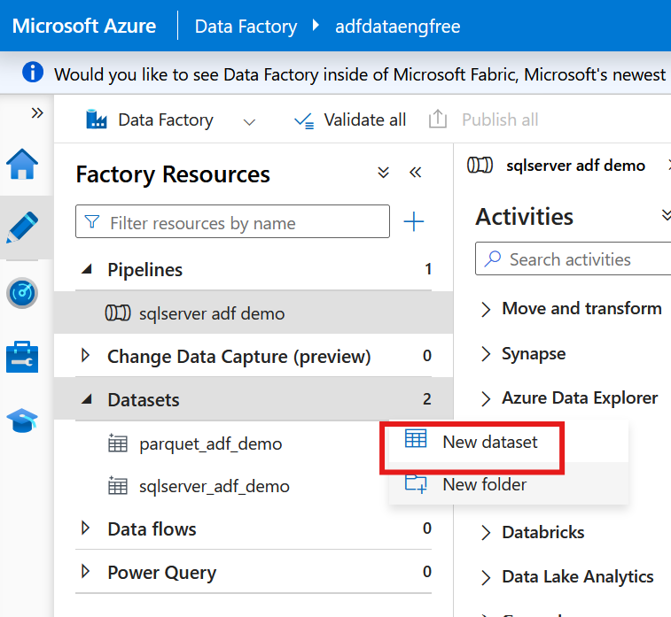

Slide 25
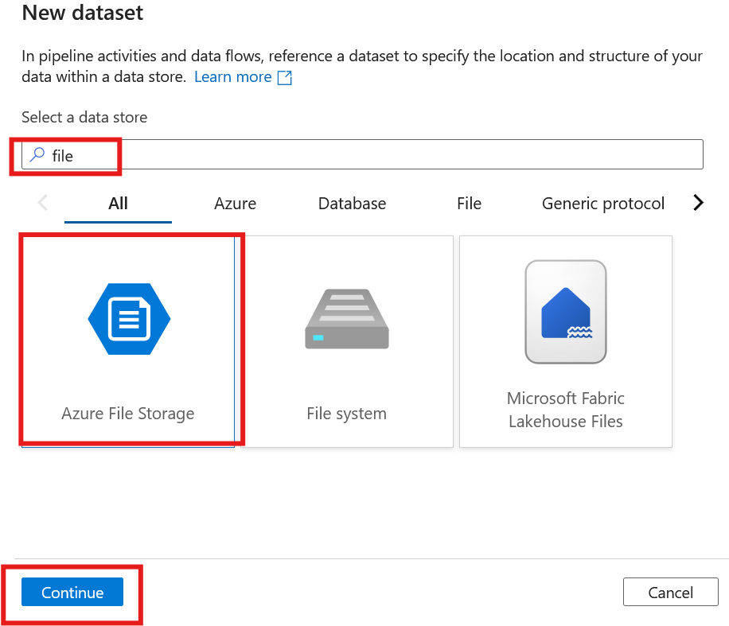
Notes:
S

Slide 26
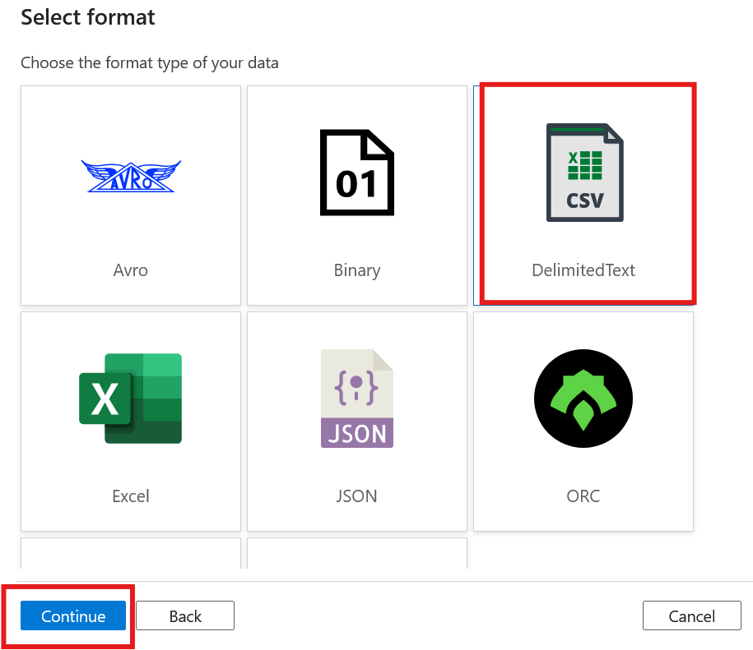

Slide 27
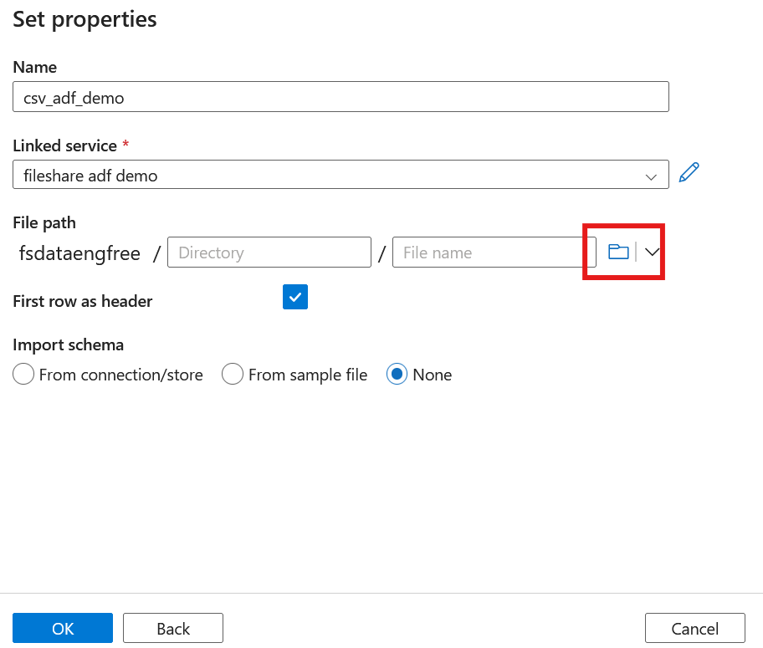
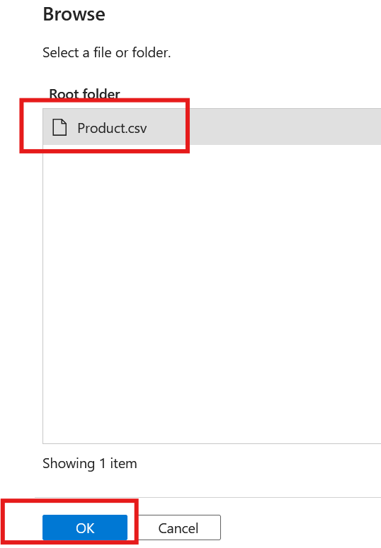

Slide 28
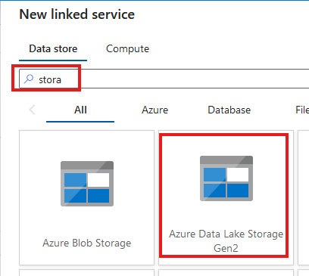
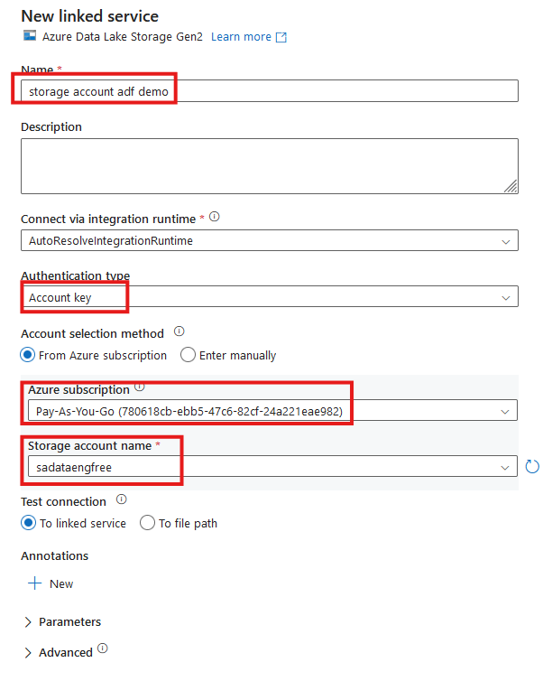


Slide 29
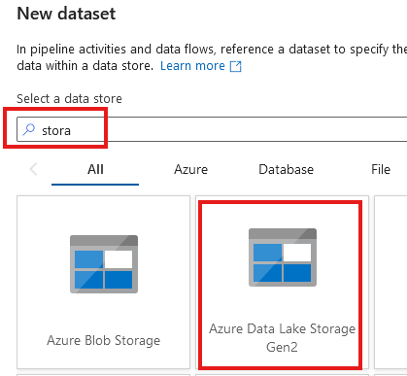
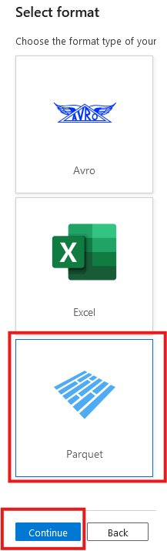

Slide 30
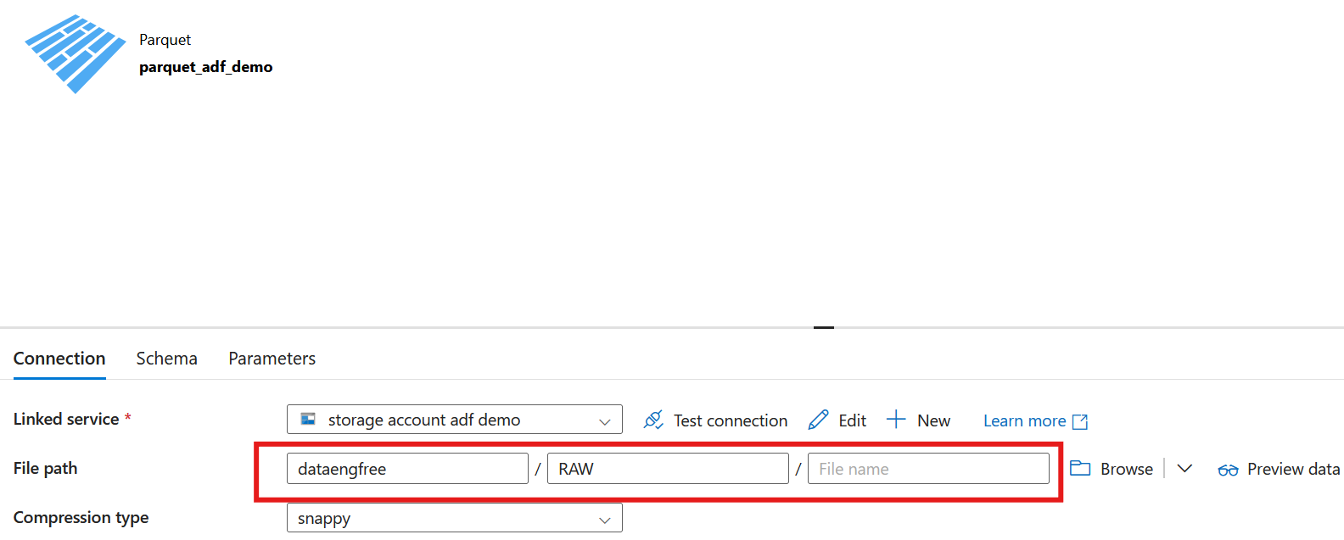

Slide 31
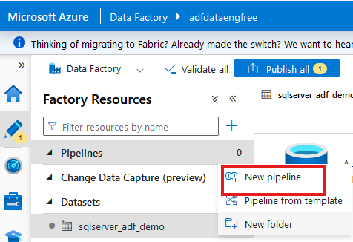
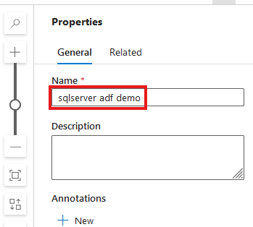

Slide 32
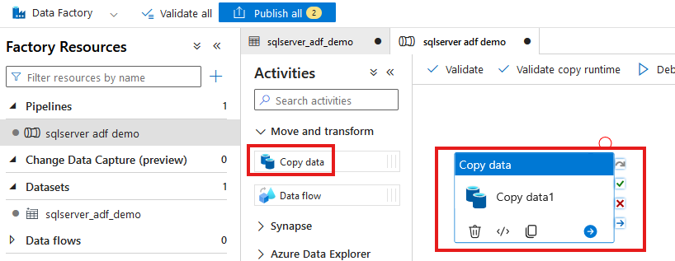

Slide 33
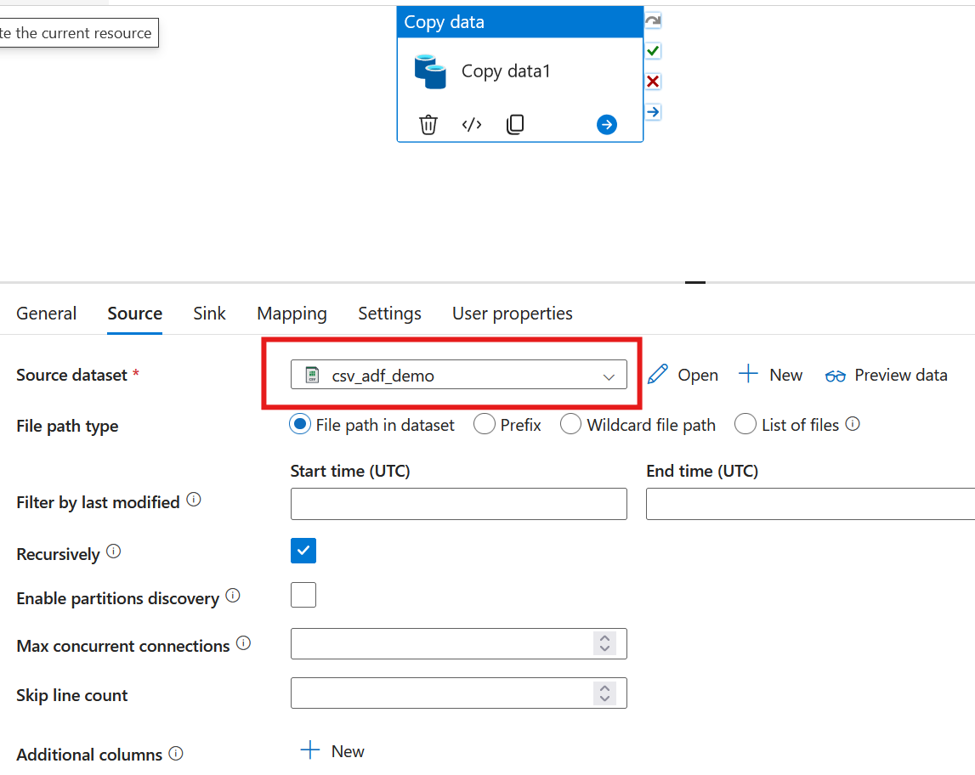

Slide 34
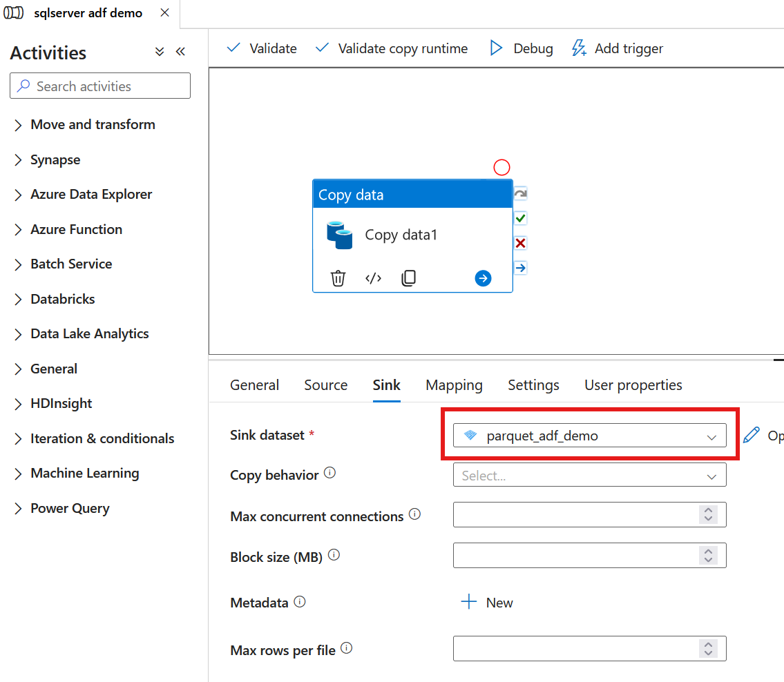

Slide 35
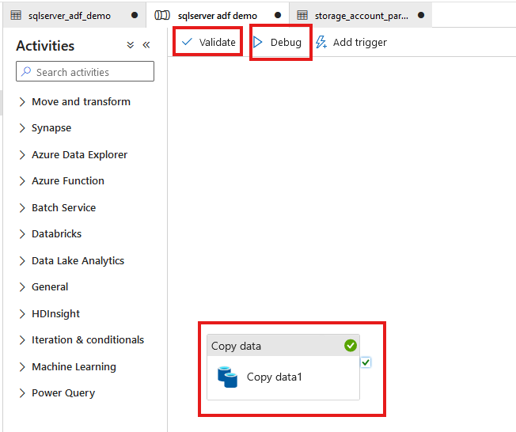

Slide 36
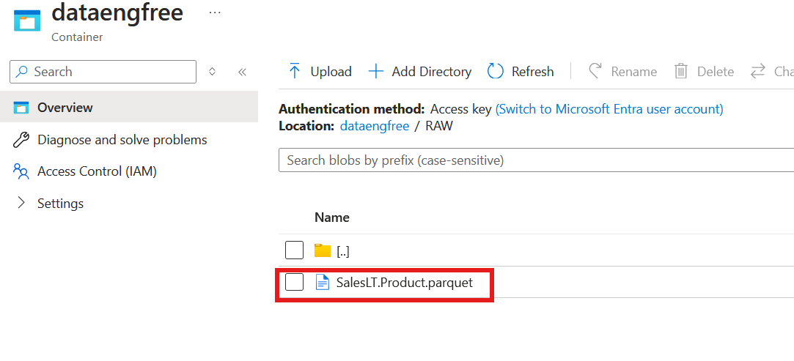

Slide 37
Azure CLI Part II

Slide 38
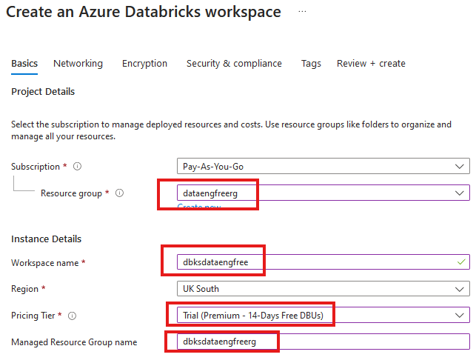


Slide 39
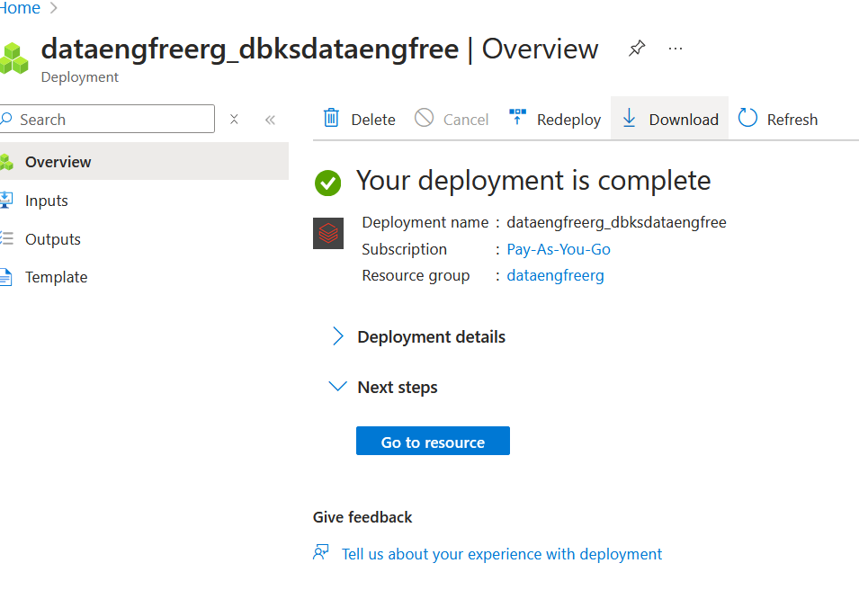

Slide 40
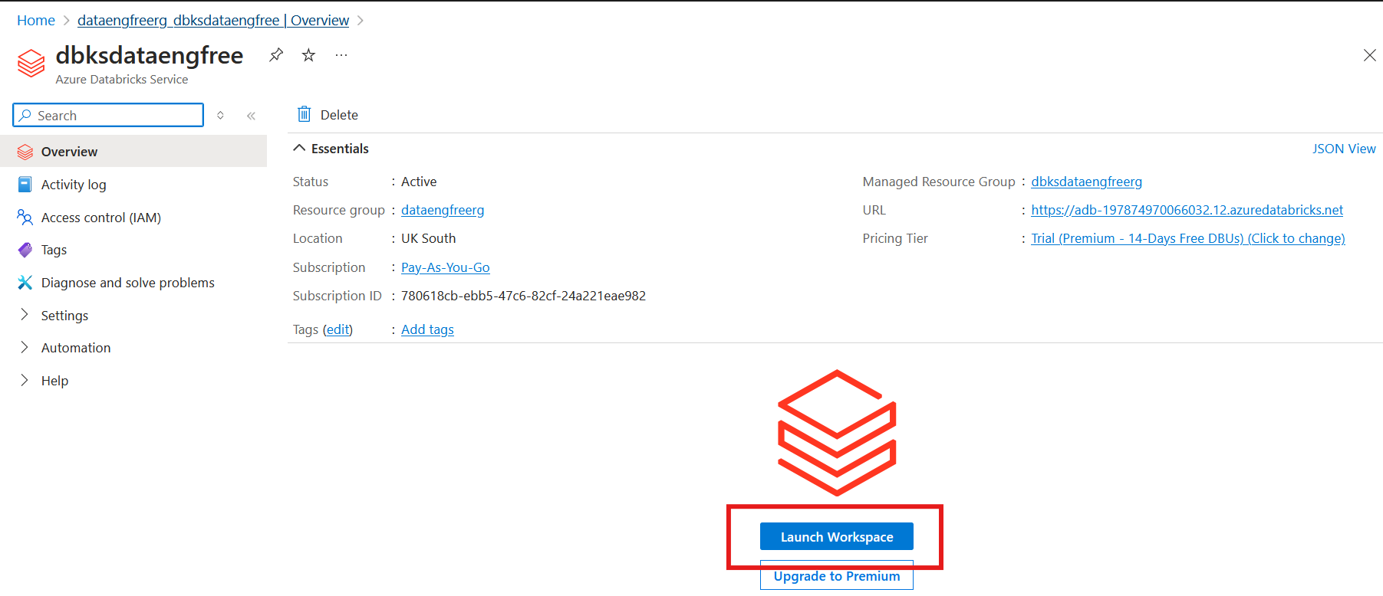

Slide 41
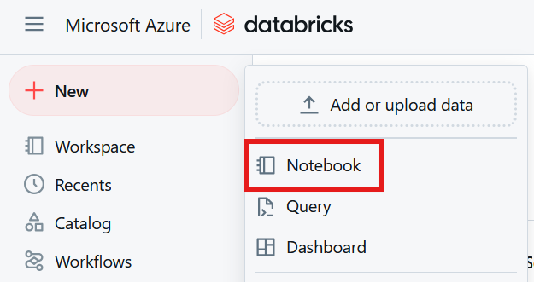

Slide 42
Databricks Demo

Slide 43
Data Engineering locally

Slide 44
Python
What is Python?

Slide 45
Python
What is Python?
Use Anaconda

Slide 46
Python
What is Python?
Use Anaconda
Use conda to create environment

Slide 47
Python
What is Python?
Use Anaconda
Use conda to create environment
Might need to enable Long Paths

Slide 48
Python
What is Python?
Use Anaconda
Use conda to create environment
Might need to enable Long Paths

Slide 49
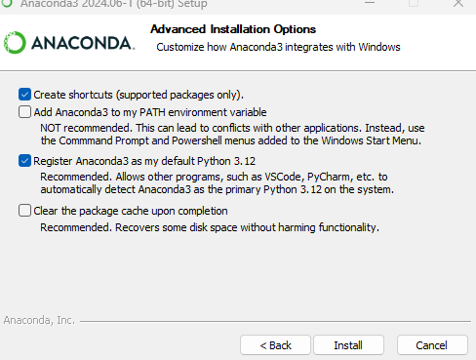
Anaconda install

Slide 50
Conda demo

Slide 51
Apache Spark
Spark

Slide 52
Apache Spark
Spark
PySpark

Slide 53
PySpark Pre-requisites
Install Java v17

Slide 54
PySpark Pre-requisites
Install Java v17
Set paths in environment variables
JAVA_HOME
PATH

Slide 55
PySpark Pre-requisites
Install Java v17
Set paths in environment variables
JAVA_HOME
PATH
Install Apache Spark

Slide 56
PySpark Pre-requisites
Install Java v17
Set paths in environment variables
JAVA_HOME
PATH
Install Apache Spark
Install winutils.exe

Slide 57
PySpark Pre-requisites
Install Java v17
Set paths in environment variables
JAVA_HOME
PATH
Install Apache Spark
Install winutils.exe
Create virtual environment

Slide 58
PySpark Pre-requisites
Install Java v17
Set paths in environment variables
JAVA_HOME
PATH
Install Apache Spark v3.5.3
Install winutils.exe
Create virtual environment
Instructions: https://sparkbyexamples.com/pyspark-tutorial/

Slide 59
PySpark Demo
Uses VS Code
Notes:
PySpark validation
Web UI
VS Code
- to run Jupiter notebooks needs ipykernel installed
- from vscode run conda install -n dataengforfree_env ipykernel
- copy python.exe > python3.exe
Visualisation?

Slide 60
PySpark Demo
Uses VS Code
Needs Jupyter package installed
conda install jupyter
pip install jupyter
Jupyter extension
Notes:
PySpark validation
Web UI
VS Code
- to run Jupiter notebooks needs ipykernel installed
- from vscode run conda install -n dataengforfree_env ipykernel
- copy python.exe > python3.exe
Visualisation?

Slide 61
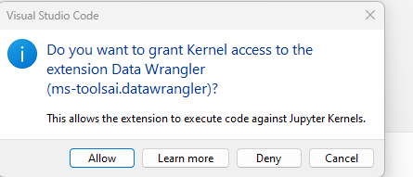

Slide 62
Quick-start SQL and Python
Tools
VS Code
Sql Server Management Studio (SSMS)
Applications
Python
SQL Server Express

Slide 63
Quick-start SQL and Python
In SSMS
Use Microsoft sample Database ‘Adventure Works’
Using SQL code to join data tables/create views
Using Import/Export Wizard, export a CSV of the views
In Python via VS Code
Import CSV
Plot a chart using Plotly
Load CSV using Pandas, and plot a chart with Plotly

Slide 64
Follow-up Resources
Microsoft Learn: https://learn.microsoft.com/en-us/training/career-paths/data-engineer
PySpark instructions: https://sparkbyexamples.com/pyspark-tutorial/
Kimball: https://www.kimballgroup.com/
Downloads
Azure CLI: https://learn.microsoft.com/en-us/cli/azure/install-azure-cli
VS Code: https://code.visualstudio.com/
Java: https://www.java.com/download/ie_manual.jsp
Apache Spark: https://spark.apache.org/downloads.html
Winutils: https://pypi.org/project/WinUtils/

Slide 65

References
https://github.com/phil-a10/Talks
/Data Engineering Using Free Tools
This deck
Quick-start instructions
Supporting files

Slide 66
END
(Slides cut from in-person talk follow…)

Slide 67
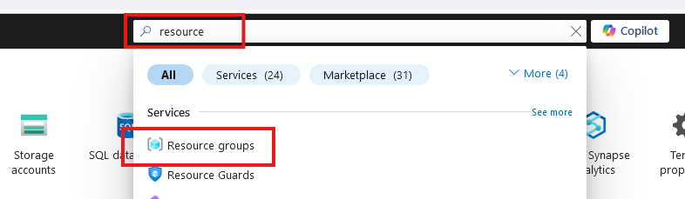
Create Resource Group

Slide 68
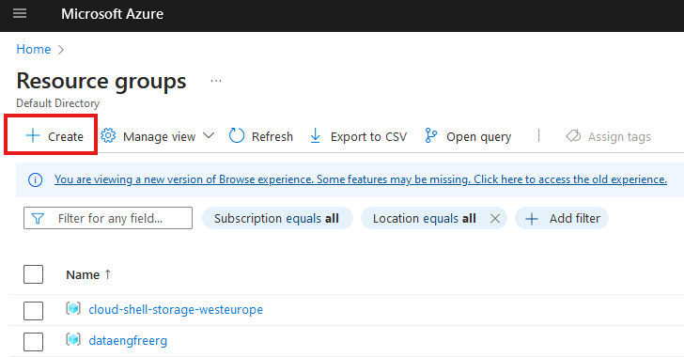
Create Resource Group

Slide 69
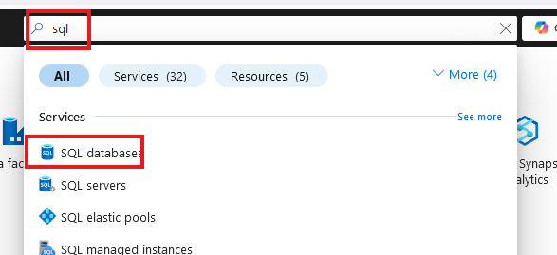
Create SQL database

Slide 70
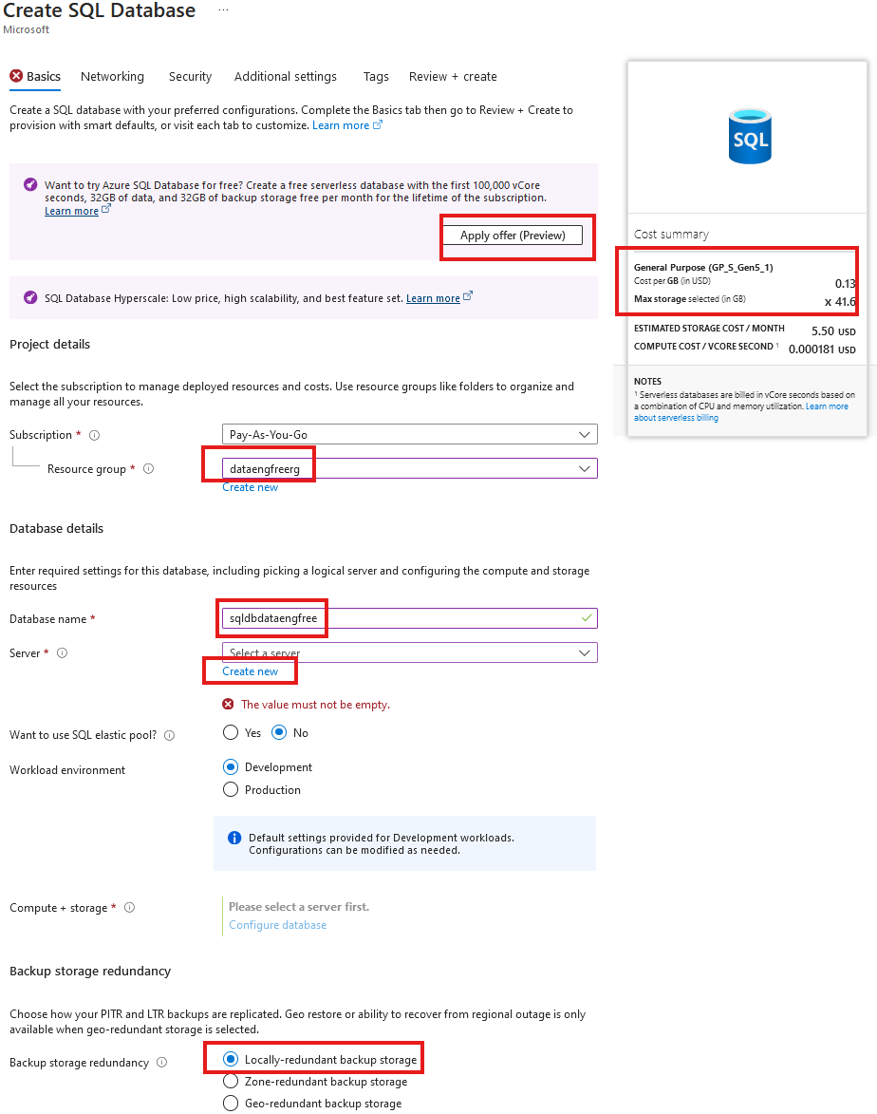
Create SQL database

Slide 71
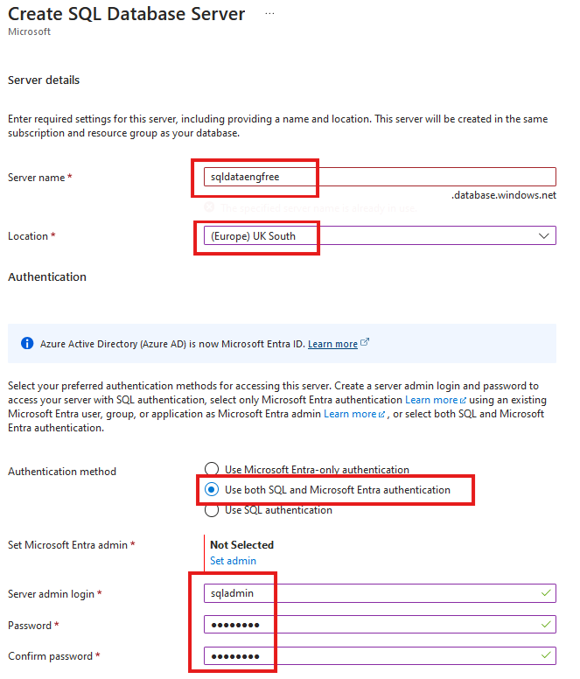
Create SQL database

Slide 72
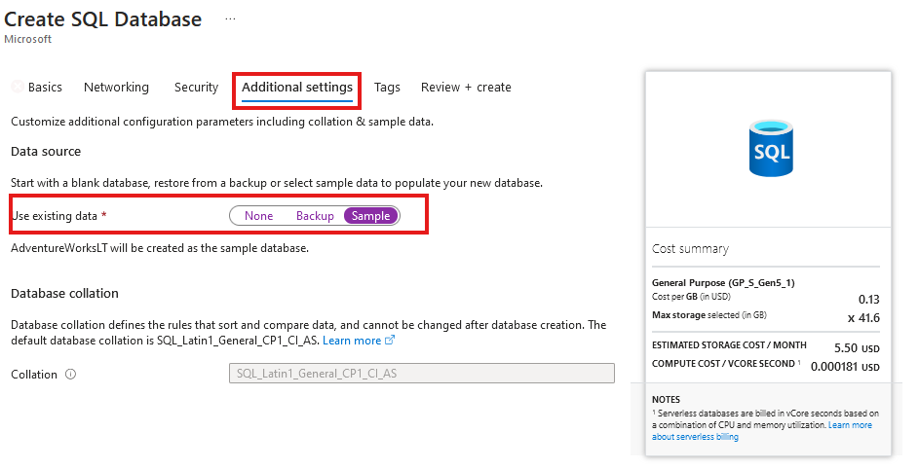
Create SQL database
Add sample data

Slide 73
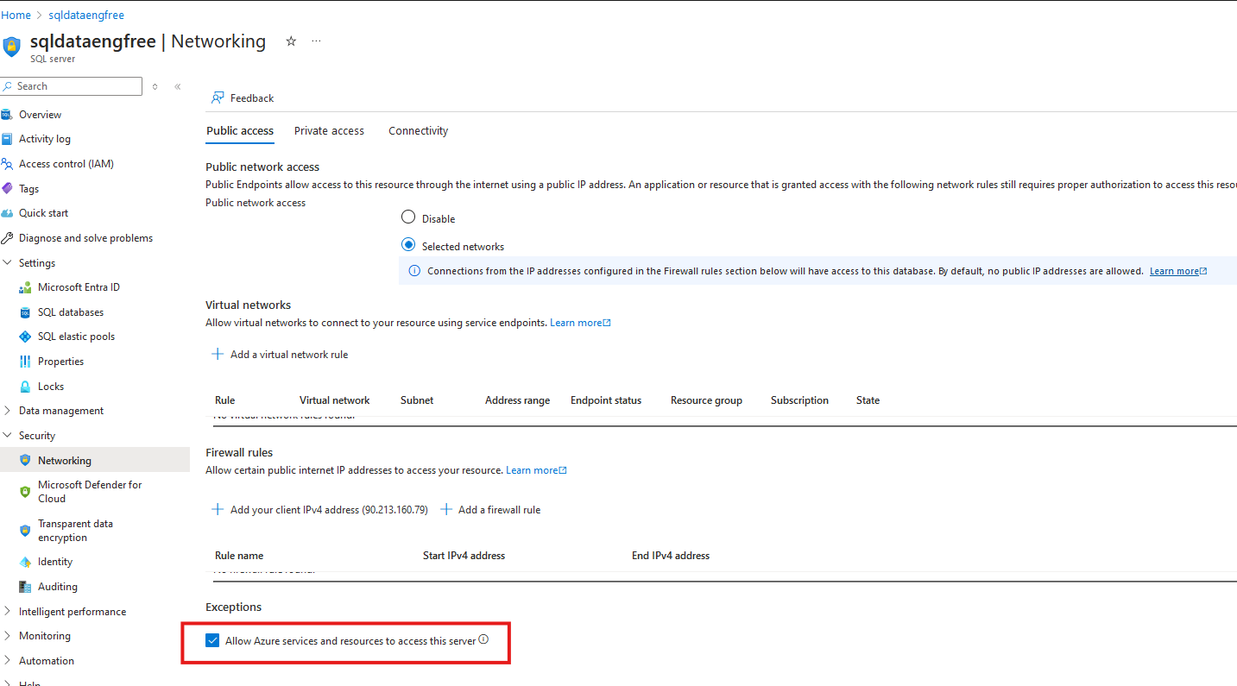
Network setting

Slide 74
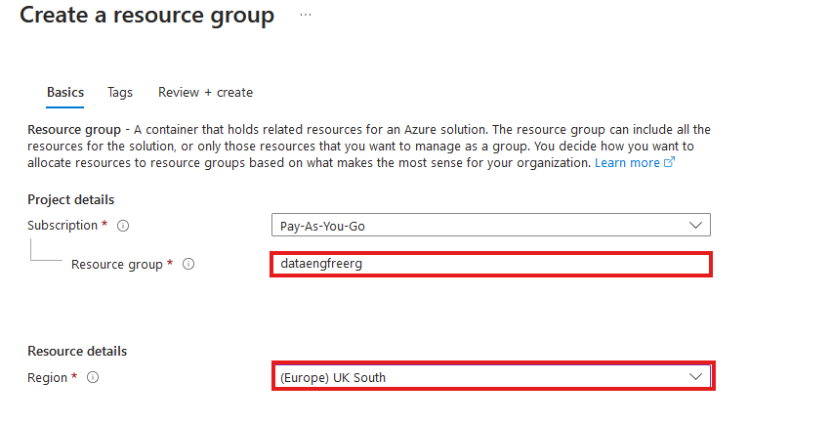
Create Resource Group

Slide 75
Azure CLI Demo

Slide 76
Create storage account
Create in same region as RG
Primary service is ADLS Gen 2
Primary workload Big Data Analytics
Performance: Standard
Redundancy: LRS
Add container > RAW directory

Slide 77
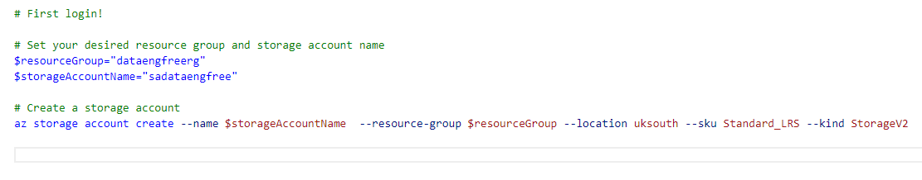
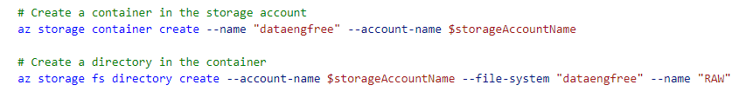
Create storage account

Slide 78
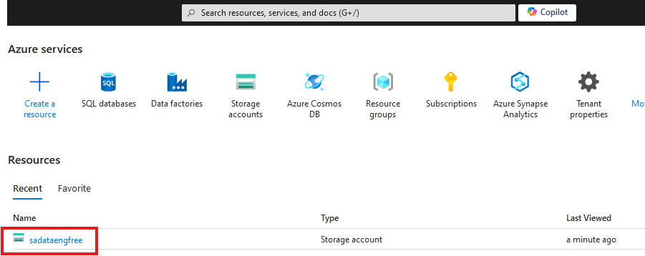

Slide 79
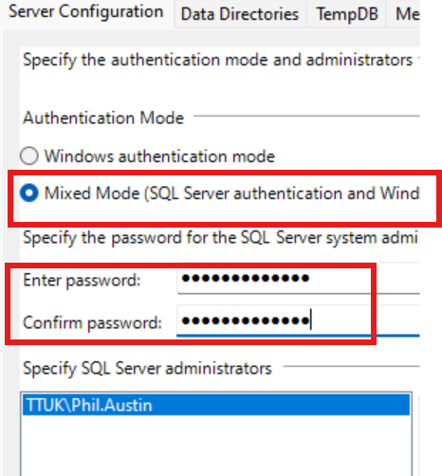

Slide 80
Create Azure Data Factory
Create in same region as RG

Slide 81
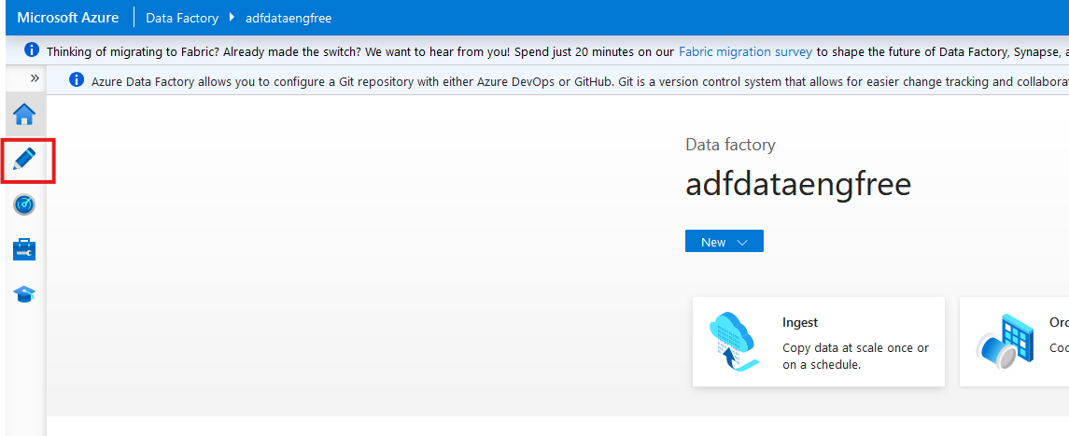

Slide 82
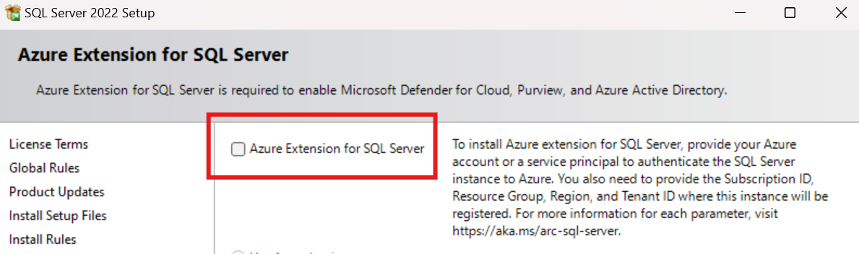
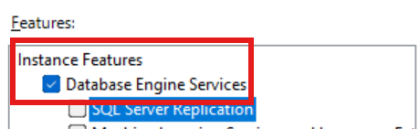
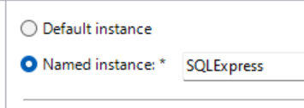

Slide 83
Data & Databases
Concepts to Learn: Data types, databases (SQL and NoSQL), data structures.
Tools/Resources:
Azure SQL Database - free tier available
Cosmos DB: Explore NoSQL databases with a limited free tier on Azure.

Slide 84
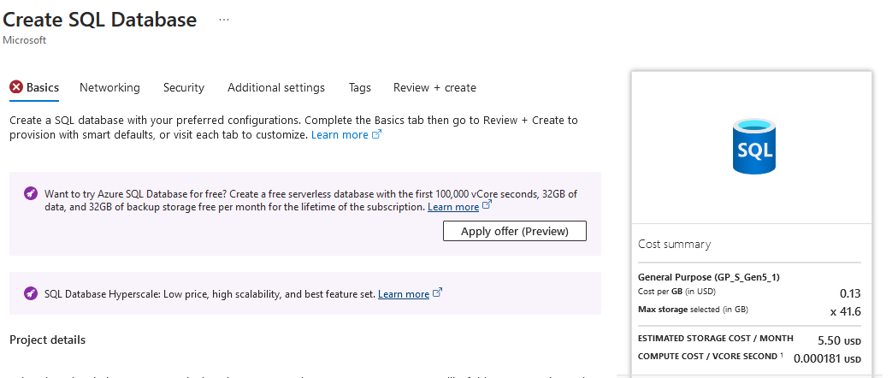

Slide 85
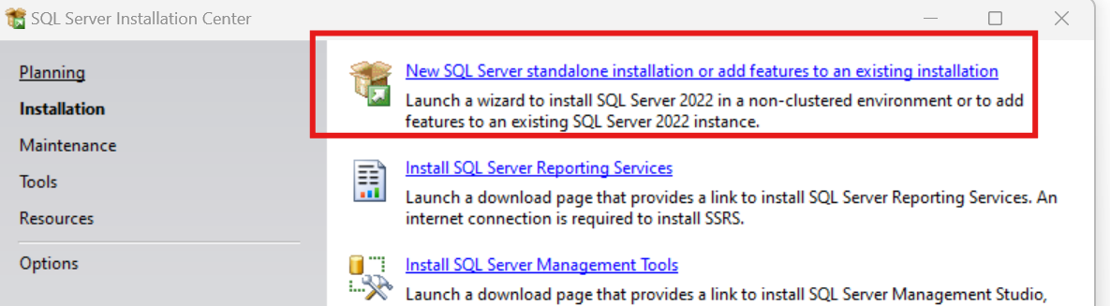
SQL Express!
https://www.microsoft.com/en-us/download/details.aspx?id=104781&lc=1033

Slide 86
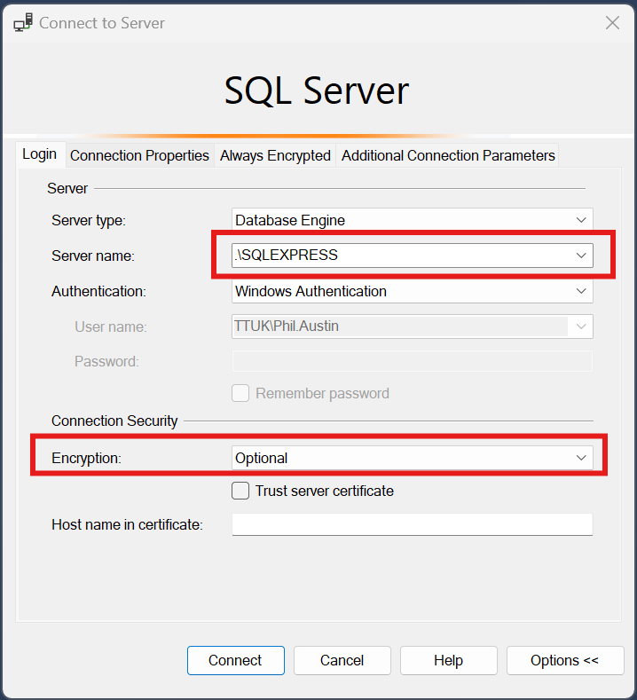

Slide 87
Download JDBC driver: https://repo1.maven.org/maven2/com/microsoft/azure/spark-mssql-connector_2.12/1.2.0/spark-mssql-connector_2.12-1.2.0.jar
Copy jar file to anaconda jars folder

Slide 88
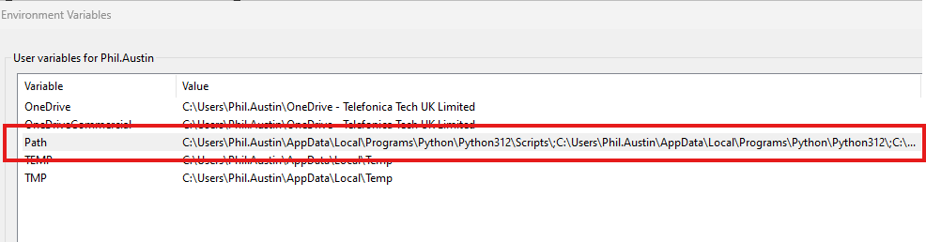

Python pre-reqs

Slide 89



Slide 90



Slide 91



Slide 92


Slide 93


Slide 94


Slide 95



Slide 96


Slide 97

Create storage account

Slide 98

Create storage account

Slide 99

Create storage account

Slide 100



Slide 101


Create Azure Data Factory (ADF)

Slide 102
Create Azure Data Factory (ADF)

Slide 103

Create Azure Data Factory (ADF)

Slide 104


Slide 105


Slide 106


Slide 108
PySpark

